Slide 1
Student Field Experiences Guide
The stuff that you need to know.

Slide 2
EDTP 107:
Your placements will be 7 hours for EACH session. You will also have one additional hour of placement at the Early Learning Campus that will be scheduled for you to attend by your professor, with your class. This means a total field placement requirement for you is 15 hours.
EDTP 201:
Your placements will be 9 hours for EACH session. This means a total field placement requirement for you is 18 hours.
You are NOT permitted to complete any of your specified hours outside of the outlined session times.

Slide 3
Preparing For Placement
Things to Know
1. Get paperwork done
2. Contact your mentor teacher quickly and professionally
3. Maintain a professional appearance and demeanor at your placement
4. Log everything

Slide 4
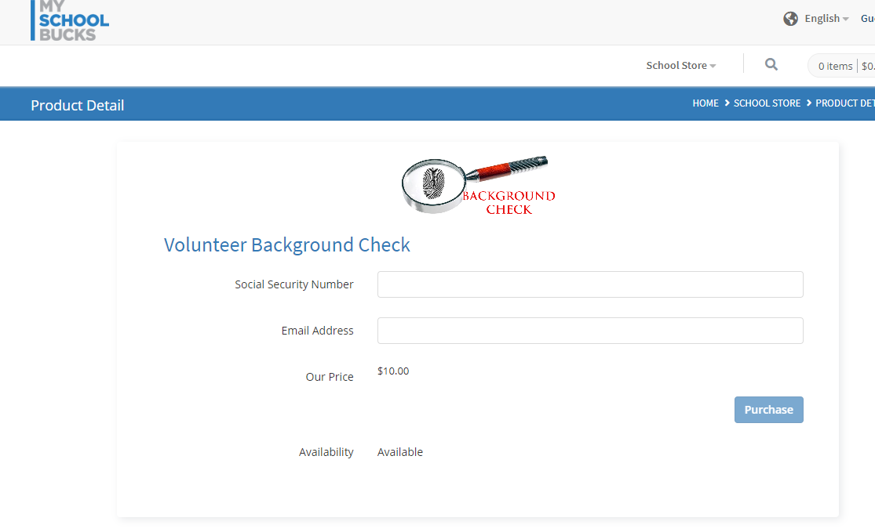
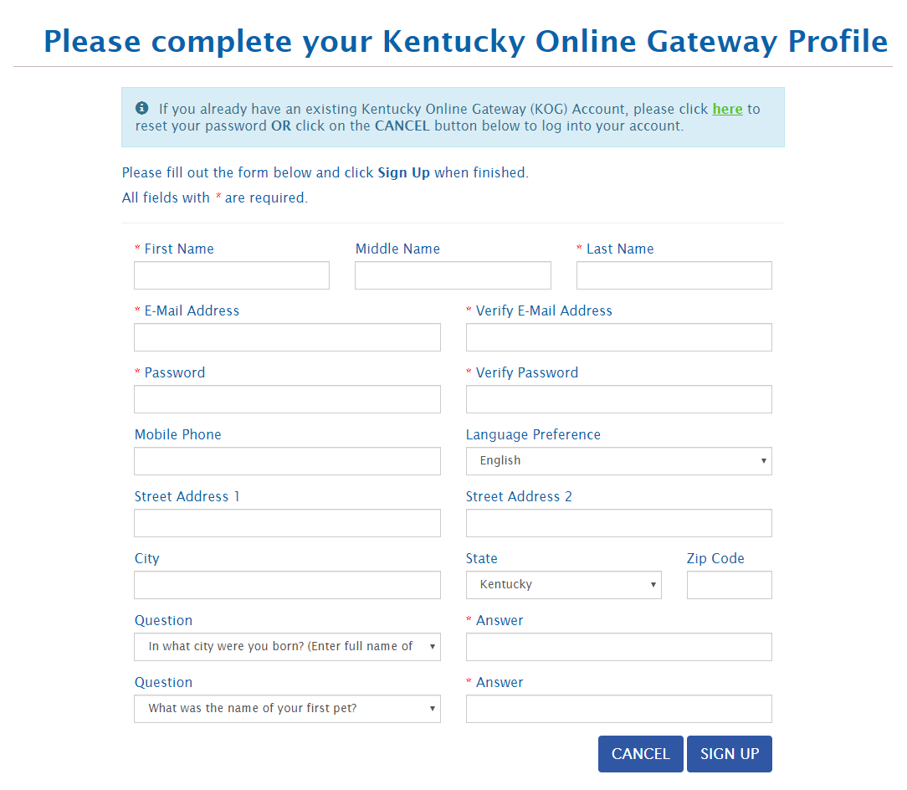
University Student Background Check
1. Get the paperwork done
Child Abuse and Neglect (CAN) Check
More info HERE
(https://apps.jefferson.kyschools.us/StudentTeachers/com/Field)

Slide 5
2. Contact your mentor teacher quickly and professionally

Slide 6
Once you receive your field placement…
It is up to you to make first contact, via email, with your mentor teacher, before or near the start of each session. If you do not hear back from your mentor teacher within 3 days, check to ensure that you have typed the correct email address. Then call the school to make sure you have the correct email address. Some teacher email addresses can be found on the schools’ websites. If you are still unable to contact the teacher, via email, email the placement coordinator for further assistance. Do not wait more than a week to do this, as that gives you less time to complete your hours. Also, verify with the teachers that they have the correct contact information for you.
Placement locations and transportation.
Inform the placement coordinator ASAP about any transportation issues
When placing students, the placement coordinator assumes you are starting at U of L’s campus
PLEASE NOTE: You will NOT be given the name of your mentor teacher your University Student Background check and CAN check have been received by the placement coordinator.

Slide 7
In your initial email, be sure to include:
Your availability!
Ask when your placement teacher has planning period and when the students are at lunch.
For high schools especially- ask where to park.
Know which entrance to use to check in at the main office.
Copy your 107/201 instructor on your email to the mentor teacher.
Reminder: This is a professional email.
*******ALL EMAILS MUST BE THROUGH YOUR UofL ACCOUNT.

Slide 8
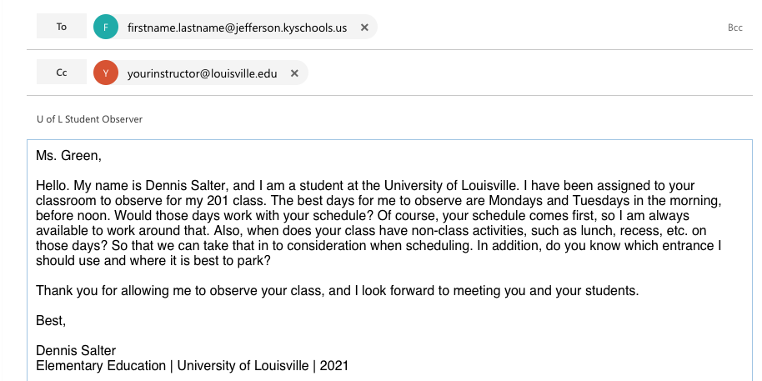
FYI: All JCPS emails end in “@jefferson.kyschools.us”

Slide 9
3. Maintain a professional appearance and demeanor at your placement

Slide 10
Professionalism and Expectations
Please show up on time and on the days you committed to; stay the entire scheduled time.
Ask questions about building procedures you don’t know
Remember you are a role model to these students
Check email regularly and respond promptly

Slide 11
Upon arriving:
Have your Driver’s License and your Student ID.
Introduce yourself to the receptionist, letting him or her know your name and the name of your placement teacher.
Sign in and receive a name badge, as required.
Arrive early to the classroom- DO NOT interrupt a class.

Slide 12
REMEMBER:
Please approach your placements as a job interview.
You never know who you will meet or who may be on a hiring committee later in your professional career.
Before your first day, meet/email with your placement teacher to discuss their expectations of you.

Slide 13
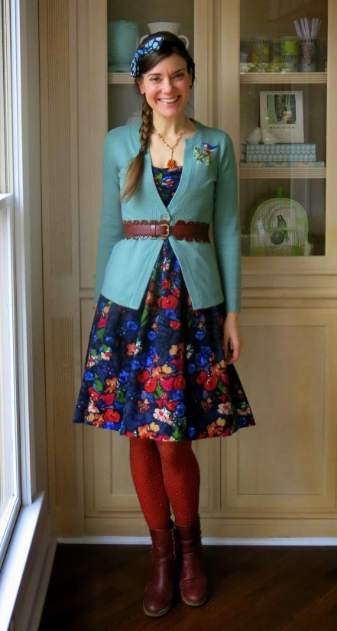
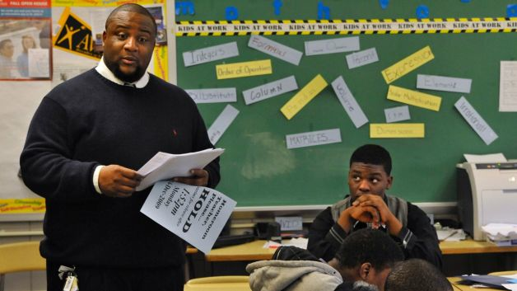
General Rule of Thumb is:
BUSINESS CASUAL

Slide 14
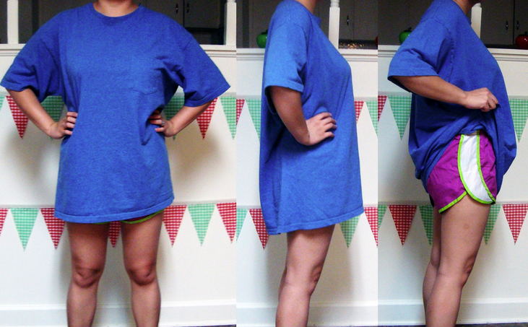
Avoid:
From JCPS:
Appropriate attire and a neat personal appearance are necessary to make a good impression on and to win the respect of the class and the school administration.
Individual schools have established dress standards; however, professional dress is always appropriate. In most schools, sweatshirts, jeans, T- shirts, and sandals are not appropriate.

Slide 15
4. Log Everything

Slide 16
State of Kentucky Requirements
This all means you need to save proof of your hours

Slide 17
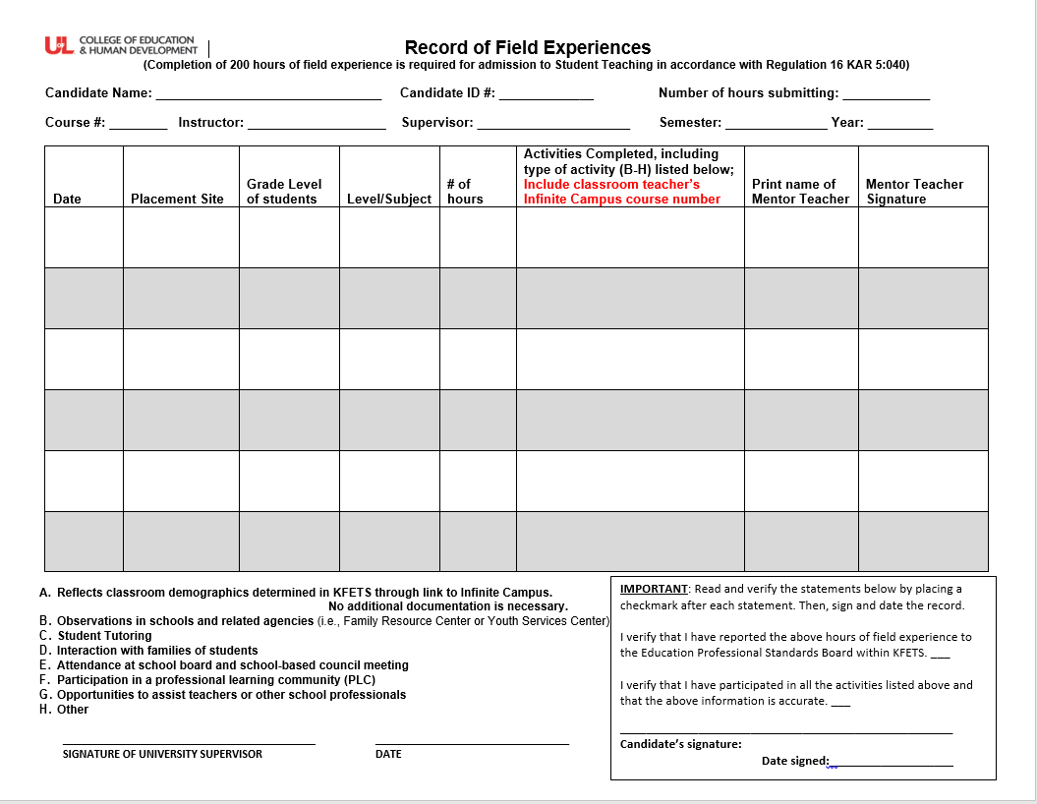
4. Log everything
Fill out ALL boxes
Infinite campus number not required at this stage
Make sure you include letter of activity performed (it will likely be B – observation)
This form is available from the placement coordinator OR the OEDCP website.

Slide 18
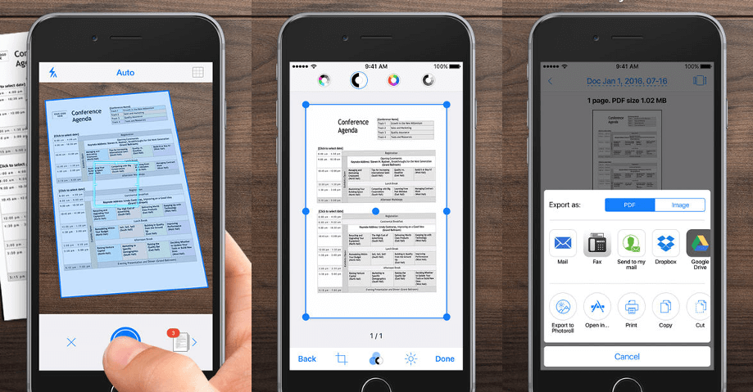
Scan or make copies of all logs – you will need them later!
If you lose them, you will have to do your hours AGAIN
Recommended apps:
CamScanner
Notes app (iPhone)
Just use camera
Scanner

Slide 19
KFETS
** Note, in 107/201 you will not need to log these hours yet; this slide is more of an FYI of what’s to come in future courses
“The Kentucky Field Experience Tracking System (KFETS) is an online application for tracking field experiences of teacher candidates enrolled in a Kentucky teacher preparation program and students who plan to enroll in a teacher preparation program in Kentucky. Candidates in Kentucky are required to complete a minimum of 200 field experience hours prior to student teaching.” (EPSB, 2014)
EDTP 107 and EDTP 201 Students
PLEASE KEEP YOUR ACTIVITY LOGS IN A SAFE (VERY SAFE) PLACE. IF YOU DO NOT HAVE THE INFORMATION ON THESE LOGS, THE HOURS WILL NEED TO BE REPEATED BEFORE YOU APPLY FOR TEACHER CANDIDATE (STUDENT TEACHING) STATUS.
Copies must be kept by you! We do not keep logs at the OEDCP, and your professor does not keep logs.
http://louisville.edu/education/field-placement/forms/log-record-field-experiences-updated-fall-17.pdf
For further information, please visit the OEDCP website at http://louisville.edu/education/field-placement/state-requirements or email denise.townsend@louisville.edu

Slide 20
KFETS
** Note, in 107/201 you will not need to log these hours yet; this slide is more of an FYI of what’s to come in future courses
https://wd.kyepsb.net/Epsb.WebApps/Login/Login.aspx

Slide 21
Questions?
Contact the current placement coordinator
Cody Windhorst (cody.hinton@louisville.edu)
OEDCP Director
Denise Townsend (denise.townsend@louisville.edu )
Assessment Specialist

